Slide 1
DRL for Stock Trading in Bangladesh
Supervised by: Ajmain Yasar Ahmed
Presented by: 1805091 & 1805093

Slide 2
Motivating Factors
Stock Exchange is a very unpredictable & turbulent sector. Predicting it and trading automatically is an interesting problem itself.
Other Neural Network based models try to predict the future values of portfolios, not trade automatically.
Reinforcement Learning based models would learn the ways of the stocks in a more intense way as it continuously trades and reinforces itself.
Stock Market in Bangladesh is so much unstable comparing to other countries’, it raises a curiosity to see how does Deep RL models work here.

Slide 3
Overview
Model adopted from FinRL
Dataset taken from Kaggle

Slide 4
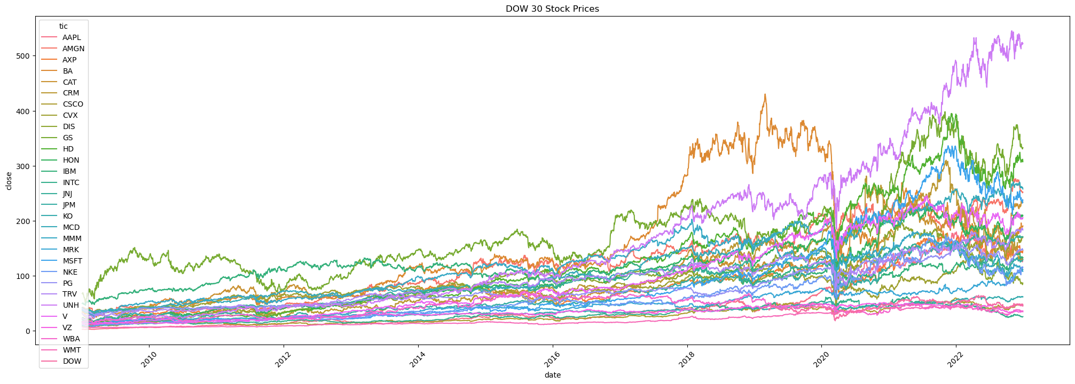
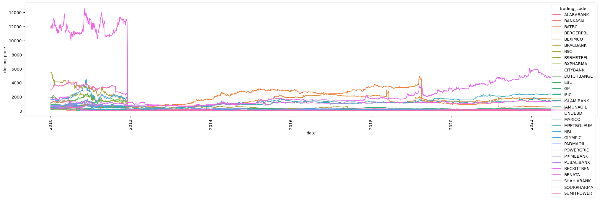
Trends in DJI & DSE
2009 to 2022

Slide 5
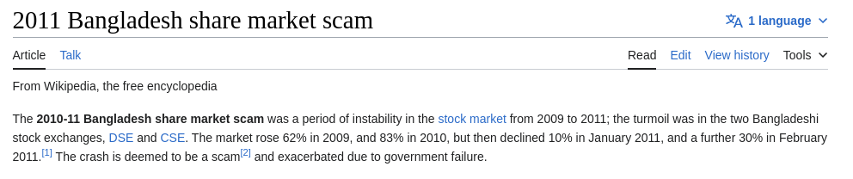
Why DSE fluctuate too much around 2011?

Slide 6
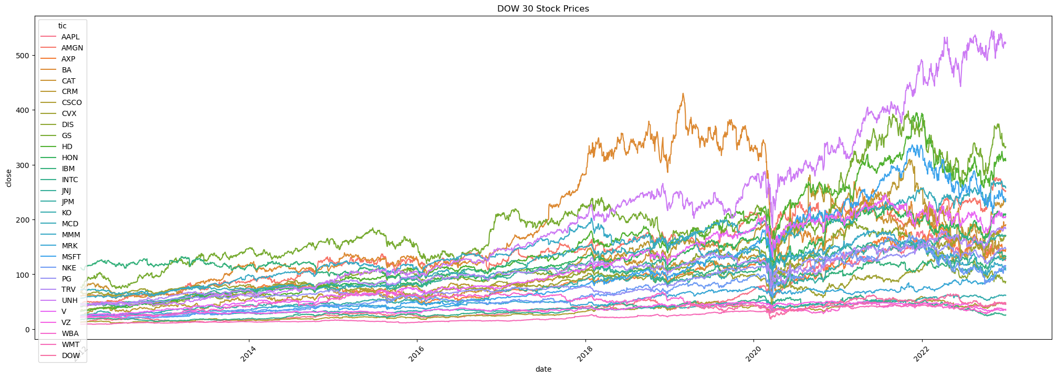
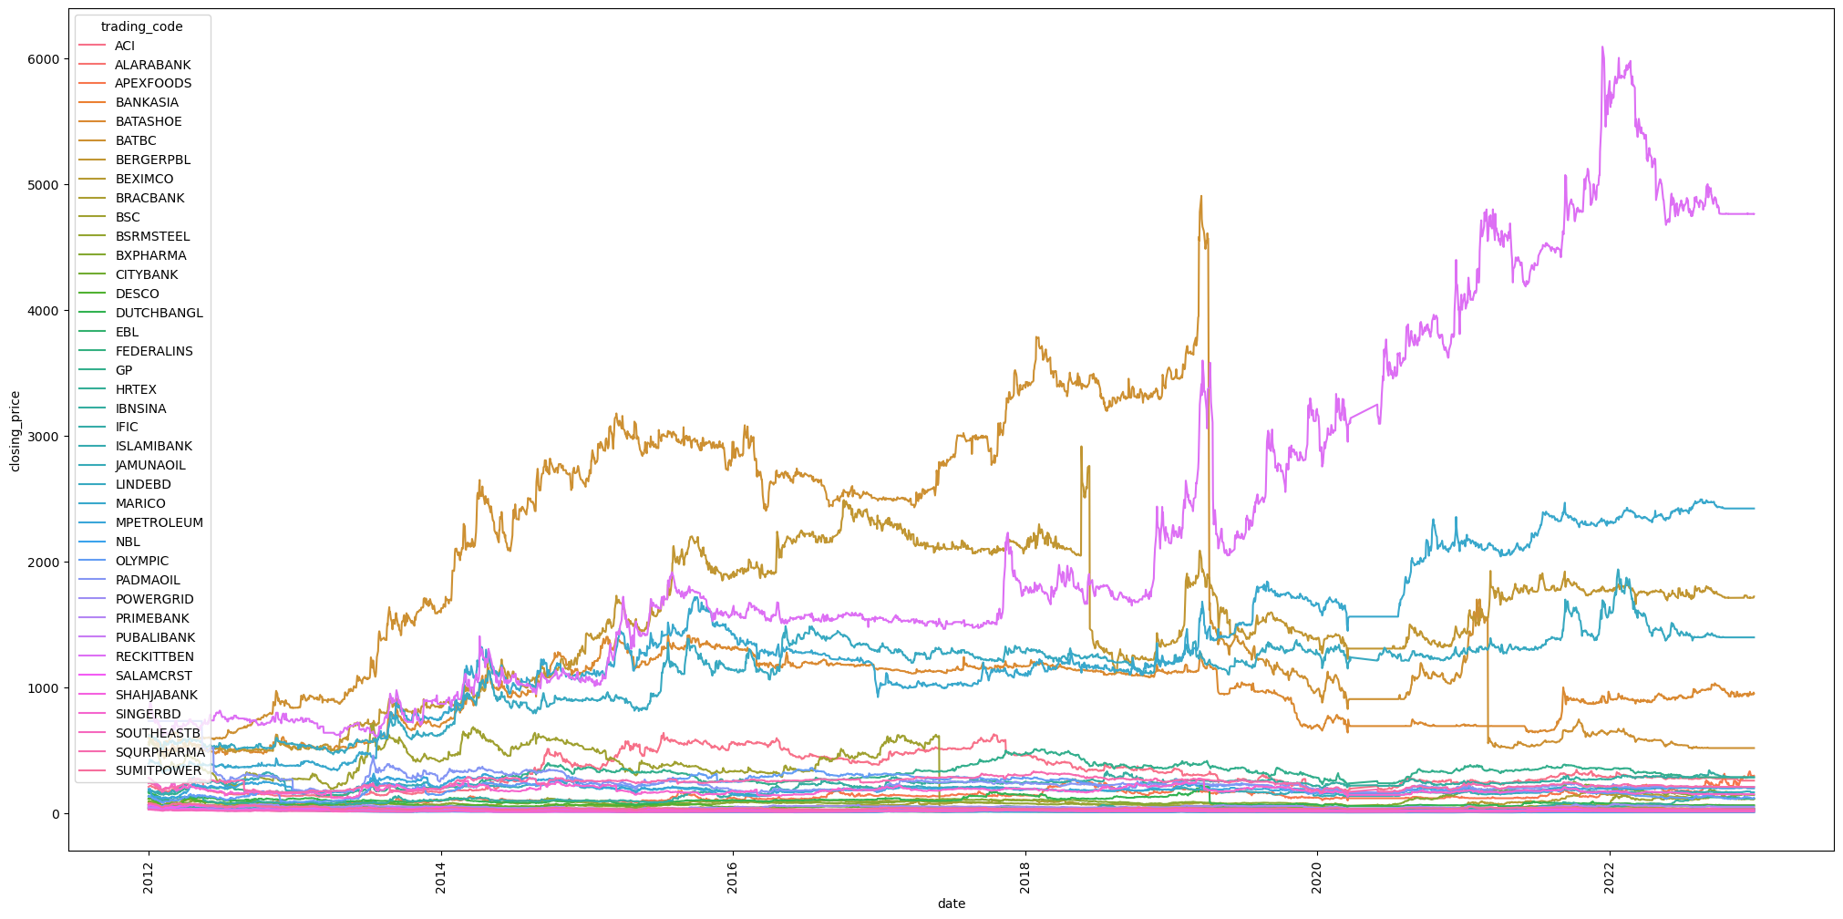
Trends in DJI & DSE
2012 to 2022

Slide 7
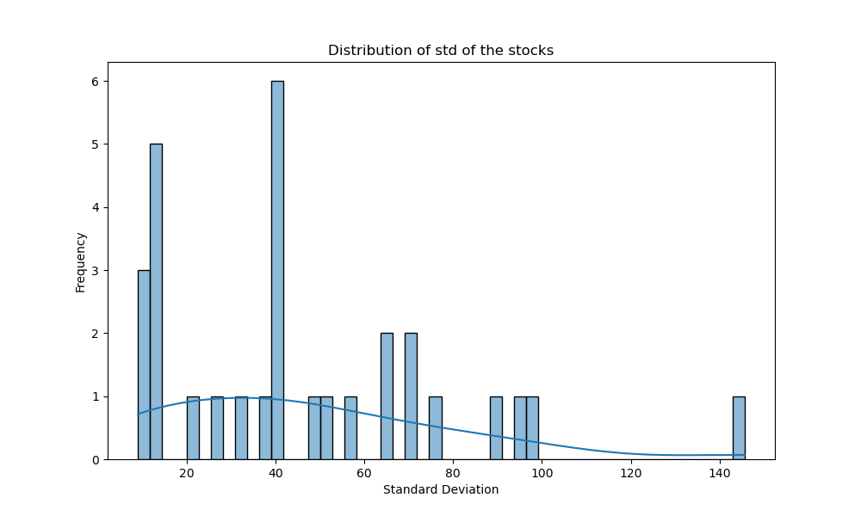
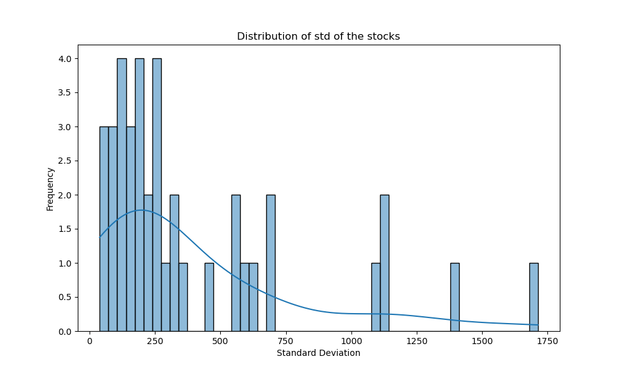
Distribution of Standard Deviation of DSE and DJI top companies

Slide 8
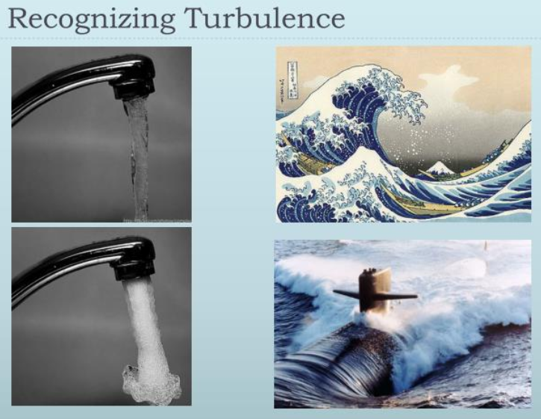
Turbulence
Market turbulence is the unexpected rising and falling of the stock market

Slide 9
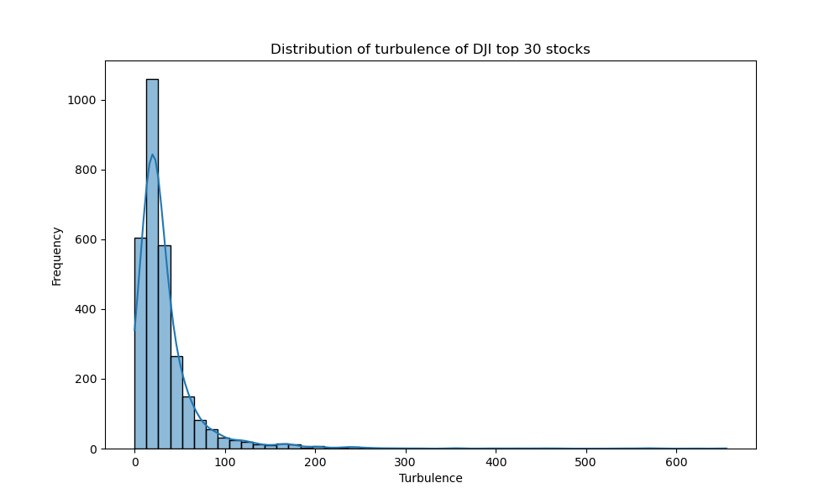
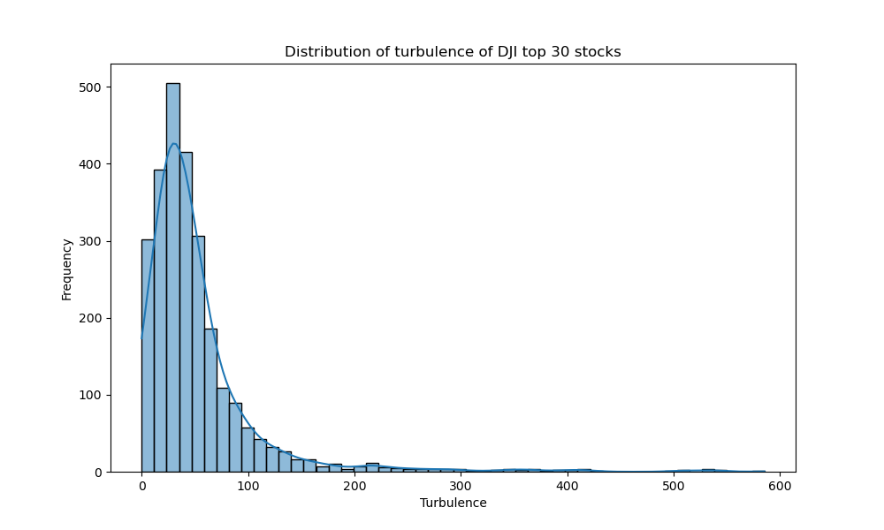
Turbulence distribution in DSE and DJI

Slide 10
Volatility Index - VIX
Measures insecurity in the stock market.
When the VIX is high, people are not buying which is also called market fear.
"If the VIX is high, it's time to buy"
"When the VIX is low, look out below!"
Buying when the VIX is high and selling when it is low is a strategy, but that needs to be considered against other factors and indicators too.

Slide 11
Stock Market Indicators:
MACD (Moving Average Convergence Divergence): Trend-following momentum indicator based on moving averages.
Bollinger Bands (Boll_ub and Boll_lb): Volatility bands indicating potential overbought or oversold conditions.
RSI (Relative Strength Index) 30: Momentum oscillator for identifying overbought or oversold conditions.
CCI (Commodity Channel Index) 30: Momentum oscillator for assessing trend strength and overbought/oversold conditions.
DX (Directional Movement Index) 30: Measures trend strength in a security.
Close_30_SMA and Close_60_SMA: Simple moving averages based on closing prices over 30 and 60 days respectively.

Slide 12
Models Used
A2C [Advantage Actor Critic]
DDPG [Deep Deterministic Policy Gradient]
PPO [Proximal Policy Optimization]
TD3 [Twin-Delayed Deep Deterministic Policy Gradient]
SAC [Soft Actor-Critic]

Slide 13
Mean Variance Optimization - MVO
Measuring an asset's risk against its likely return and investing based on that risk/return ratio.
The analysis helps investors determine the biggest reward at a given level of risk or the least risk at a given level of return.
The expected return is a probability expressing the estimated return of the investment in the security.
If two different securities have the same expected return, but one has lower variance, the one with lower variance is preferred.
Similarly, if two different securities have approximately the same variance, the one with the higher return is preferred.

Slide 14
Dow Jones Industrial Average - DJI
Stock market index that tracks 30 large, publicly-owned companies
Primarily focuses on the US Market
Could be somewhat relatable to other markets too

Slide 15

What Models Don’t See
Natural Calamities
War
Government Decisions
Company Policies
New Company in Market
Acquisitions etc.
That’s why an expert stock trader is most of the times more valuable than an automated software.

Slide 16
Progress
Regenerated original results.
Successfully incorporated existing RL based models from FinRL in Dhaka Stock Exchange dataset.
Designed reward function for better outcome.

Slide 17
Results

Slide 18
Default Reward Function
Only depends on the return at the end of the day.
Reward Scaling controls the rate.
Reward = daily_return * reward_scalling

Slide 19
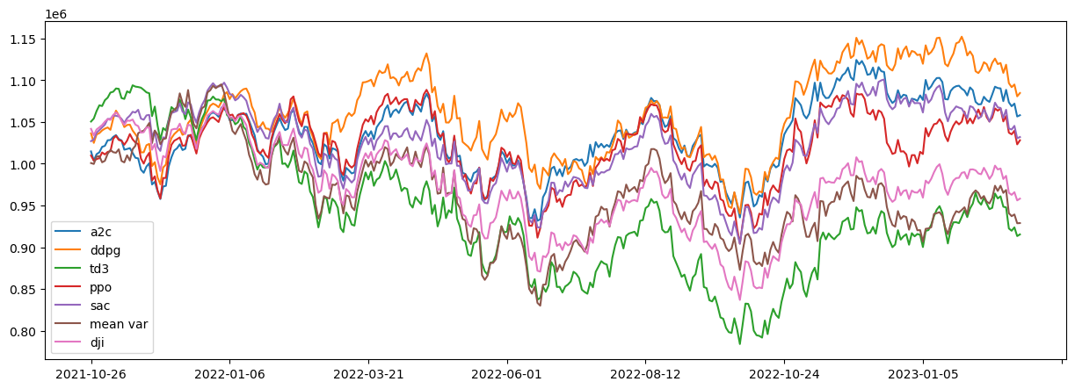
Dataset: DJIA top 29
 | initial_value | final_value | annual_return | sharpe_ratio | max_drawdown
a2c | 1014670.51891483 | 1058016.19458915 | 1.40415669825364 | 3.28099854532285E-05 | -151957.461378052
ddpg | 1036320.01684446 | 1084571.66802854 | 1.52853575693324 | 3.06601491965349E-05 | -191816.784805298
td3 | 1050454.84450713 | 915325.953889763 | -4.48619872746525 | -5.90320513395877E-05 | -309783.857719421
ppo | 1009710.06648183 | 1027998.61852467 | 0.600146922999656 | 1.49151384884493E-05 | -184124.06946183
sac | 1026971.53194534 | 1031869.39014529 | 0.158722102927555 | 3.44759921219945E-06 | -192925.196998211
mvo | 1000730.08876205 | 928866.787238764 | -2.45339499910148 | -4.53984765280635E-05 | -264967.362361946
dji | 1041671.00043766 | 958126.440812903 | -2.74825175463574 | -5.22629744627238E-05 | -235216.170014614
Train 2010-2020 Trade 2021-2022

Slide 20
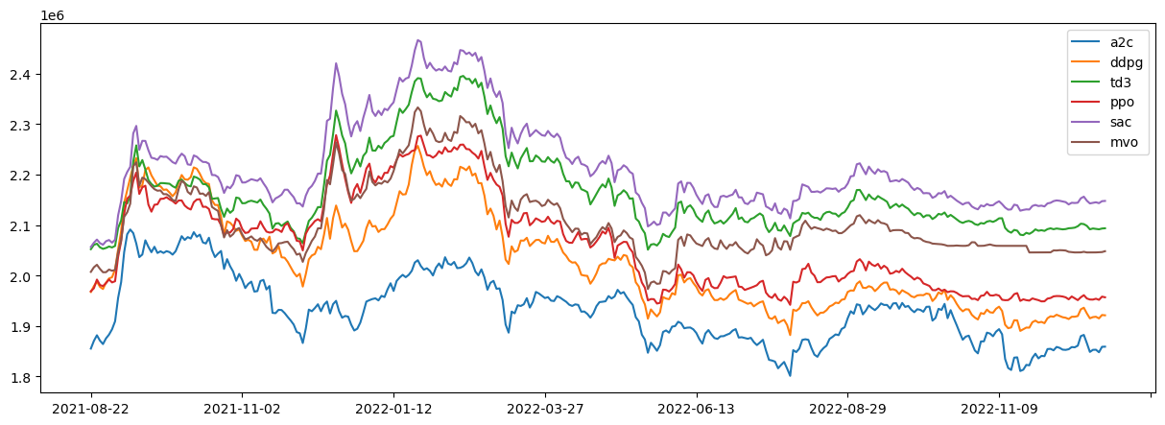
Dataset: DSE top 39
01. Train 2010-2020 Trade 2021-2022

Slide 21
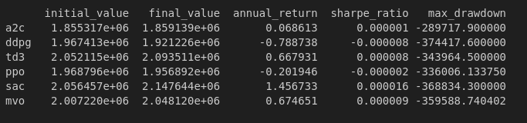
Dataset: DSE top 39
01. Train 2010-2020 Trade 2021-2022

Slide 22
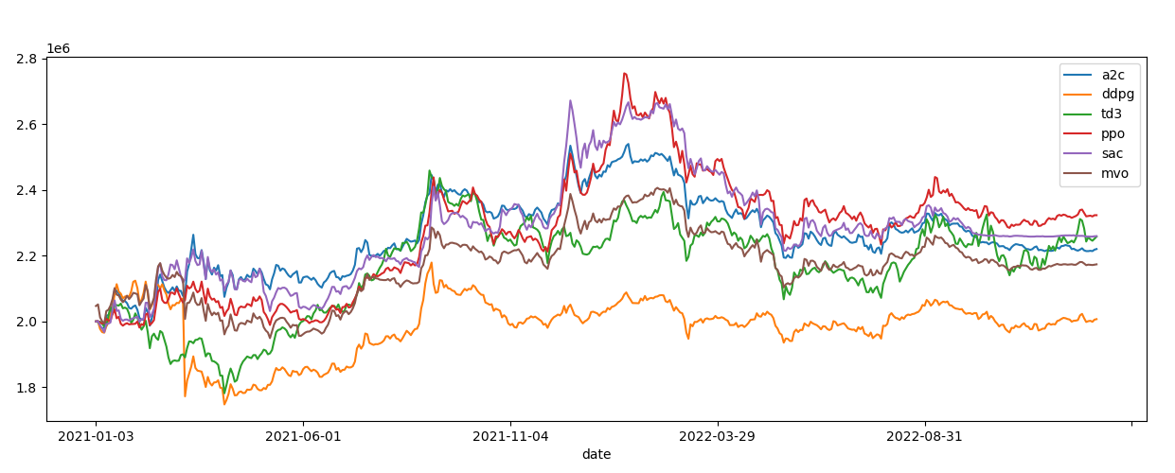
Dataset: DSE top 39
02. Train 2012-2020 Trade 2021-2022

Slide 23
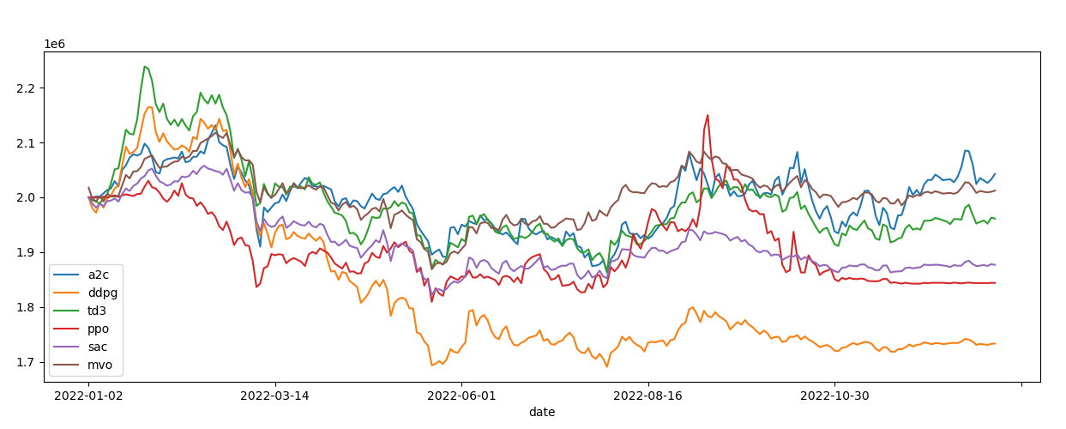
Dataset: DSE top 39
03. Train 2012-2021 Trade 2022

Slide 24
Custom Reward Functions
Cashless Penalty
Absence of cash when a stock is doing good and it should be bought.
Not having the ability to buy a stock at the right moment requires penalties.
self.reward = (end_total_asset - begin_total_asset - max(0, ((self.cash+end_total_asset - self.state[0]) * self.cash_penalty_percentage - self.cash))*self.cash_penalty_percentage) * self.reward_scaling

Slide 25
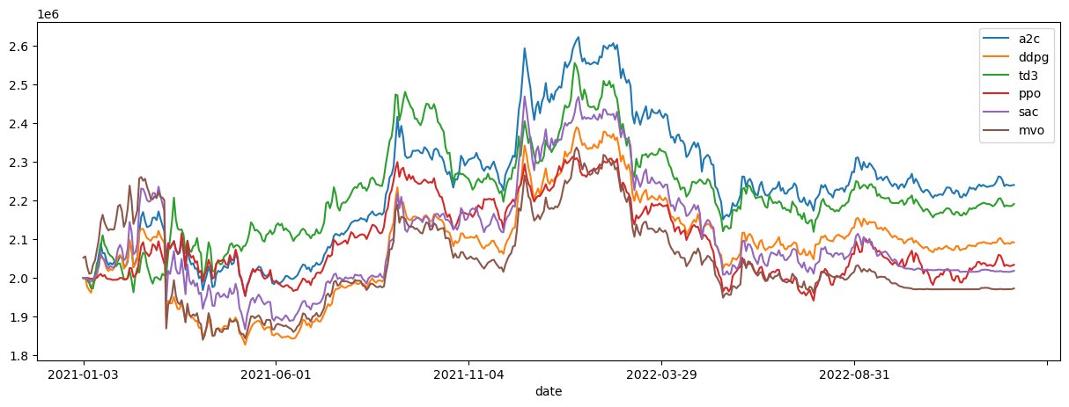
Dataset: DSE top 39
01. Cash Penalty

Slide 26
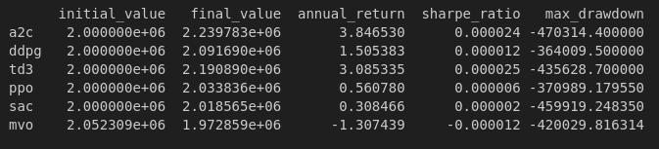
Dataset: DSE top 39
01. Cash Penalty

Slide 27
Custom Reward Functions
Stop Loss
Risk-management system that automatically sells a security once it reaches a certain price.
Designed to limit losses in case the security's price drops below that price level.
This environment penalizes the model if exceeded the stop-loss threshold, selling assets with under expectation %profit, and also for not maintaining a reserve of cash.
This enables the model to do trading with high confidence and manage cash reserves in addition to performing trading procedures.

Slide 28
Custom Reward Functions
Stop Loss
r_i = (sum(cash, asset_value) + additional_reward - total_penalty - initial_cash) / initial_cash / days_elapsed
, where total_penalty = cash_penalty + stop_loss_penalty + low_profit_penalty
cash_penalty = max(0, sum(cash, asset_value)*cash_penalty_proportion-cash)
stop_loss_penalty = -1 * dot(holdings,negative_closing_diff_avg_buy)
low_profit_penalty = -1 * dot(holdings,negative_profit_sell_diff_avg_buy)
additional_reward = dot(holdings,positive_profit_sell_diff_avg_buy)
Cash = Exponential Average of last 25 days.

Slide 29
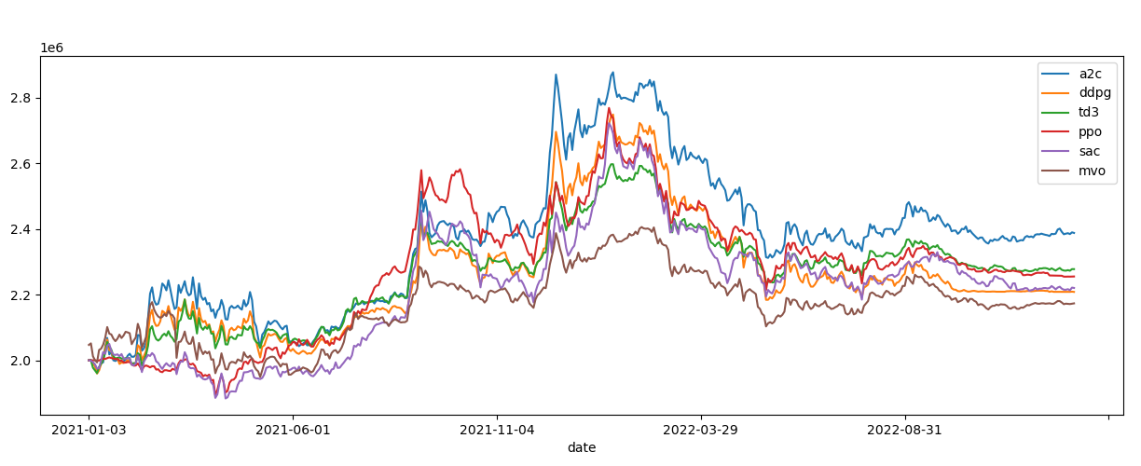
Dataset: DSE top 39
01. Train 2012-2020 Trade 2021-2022 Stop Loss

Slide 30
Dataset: DSE top 39
initial_value final_value annual_return sharpe_ratio max_drawdown
a2c 2000000.0 2220054.90 3.54 2.91e-05 -346426.19
ddpg 2000000.0 2006954.28 0.11 1.37e-06 -376089.79
td3 2000000.0 2257929.22 4.12 2.83e-05 -391398.89
ppo 2000000.0 2322867.71 5.11 2.90e-05 -520390.64
sac 2000000.0 2259114.39 4.14 2.59e-05 -456789.89
mvo 2047001.23 2173538.62 2.01 1.91e-05 -302759.42
01. Train 2012-2020 Trade 2021-2022 Stop Loss

Slide 31
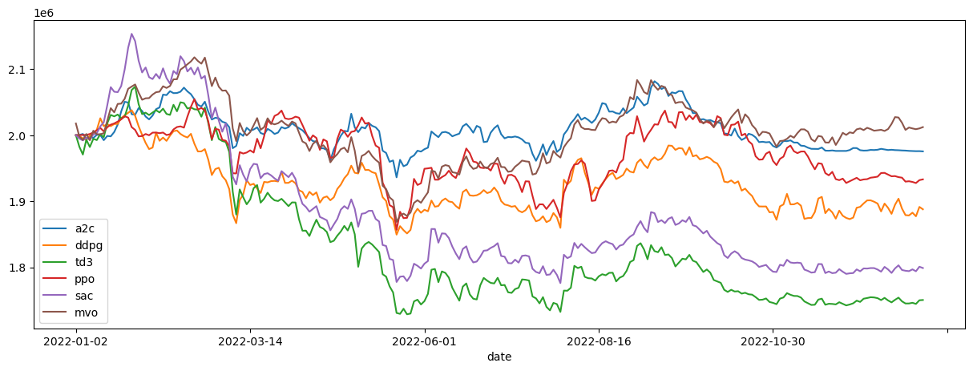
Dataset: DSE top 39
02. Train 2012-2021 Trade 2022 Stop Loss

Slide 32
Future Directions
Incorporate other factor and indicators.
Reward Functions in the FinRL library could be optimized so they match DSE’s patterns.
Guided train to minimize risk.

